Slide 1
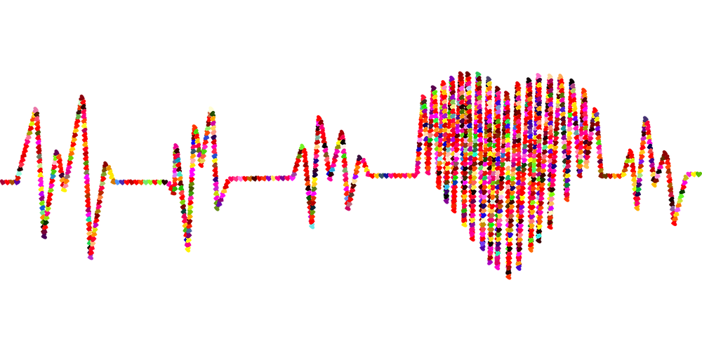
Data Analytics Bootcamp –UOT Final Project - Group 7
PREDICTION OF FACTORS LEAD TO HEART DISEASE

Slide 2
CONTENTS
Overview
Objective
What we used
Exploratory Data Analysis
Data Storage
Machine Learning Models
Dashboard
Conclusion
Our team

Slide 3
OVERVIEW :
According to the WHO, heart diseases are the leading cause of death globally. Approximately 17.9 million people die each year from heart diseases and estimated around 32% of all deaths worldwide. There have been identified many important factors which lead to heart disease. Identifying those risk factors and motivating people to adopt and following healthy behaviours is very important.

Slide 4
OBJECTIVE:
Our team use a heart disease dataset with different factors to predict which factors are at highest risk of leading to heart disease. Our team’s target audience would be the health care professionals as they will be able to apply the most current and up to date research and evidence to patient care and helping people preventing premature deaths related to heart diseases.

Slide 5
WHAT WE USED FOR THE ANALYSIS

Slide 6








Data Source and Resources Resources: Click here https://www.kaggle.com/datasets?search=heart+disease. Data Source: heart_disease_key_indicators.csv
Tools/Libraries
Technologies
Algorithms Linear Regression Random Forest Classifier Xgboosting
Languages

Slide 7
EXPLORATORY DATA ANALYSIS

Slide 8

Analytical Questions
What are the key indicators that lead to heart disease ?
What factors had the greatest influence on a person developing heart disease and in what proportions ?
Can a machine learning model accurately predict whether a person will develop heart disease based on the data provided ?

Slide 9
Understand the Data
Importing libraries and files for exploratory data analysis
Clean the Data
Analysis of relationship between variables
Creating data frame and checking number of columns and rows.
Checking the data types.
Checking the data characters mistakes.
Checking the null values.
Checking and removing the duplicates.
Transforming the target variable.
Loading data
Target variable visualization
Other variable against target variable visualizations.
Correlation Visualization.

Slide 10
Features
Independent Variables
Categorical
Smoking, AlcoholDrinking, Stroke, Sex, PhysicalActivity,
Asthma, KidneyDisease, SkinCancer, Diffwalking
Continuous
BMI, PhysicalHealth,
MentalHealth,
AgeCategory,
GeneralHealth,
Diabetic,
Sleeptime, Race
Dependent Variables
HeartDisease (Categorical)

Slide 11
Features Analysis
Categorical Variables ( Binary ) | Continuous Variables ( Non Binary )
HeartDisease Smoking AlcoholDrinking Stroke Diffwalking PhysicalActivity Asthma KidneyDisease SkinCancer Sex | BMI – Healthy Weight, Obesity, Over Weight, Under Weight PhysicalHealth – Index Number Race – Native, White, Black, Asian, Hispanic, Other MentalHealth – Index Number Age Category – In Years General Health – Excellent, Very good, Good , Fair , Poor Diabetic – Yes, No , Border line, During Pregnancy Sleeptime – In hours
Yes – 1
No – 0
Female – 1
Male – 0

Slide 12
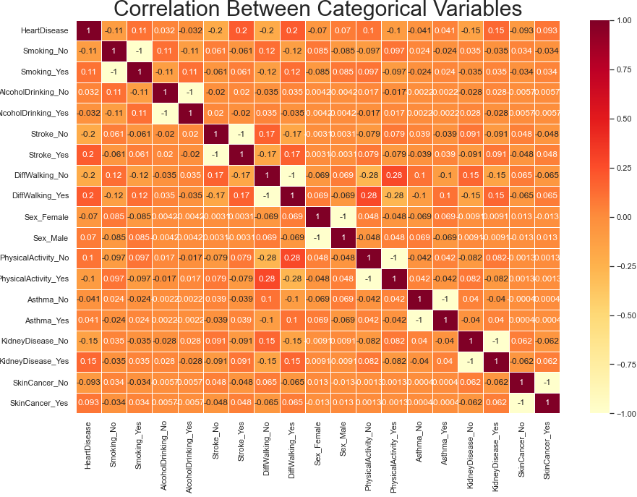
Being a person who has stroke , a person is smoking , a person with no physical activities , a person with kidney disease shows low positive correlation.
A person use alcohol shows very low negative correlation.
A person with skin cancer , a person with Asthma shows no correlation

Slide 13
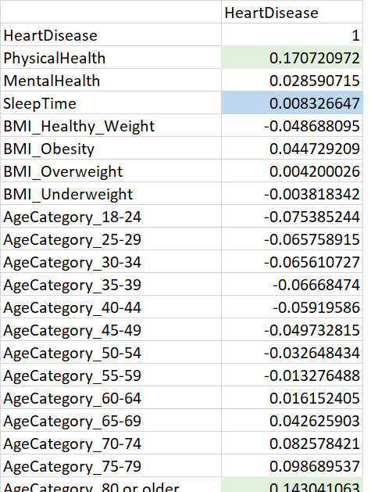
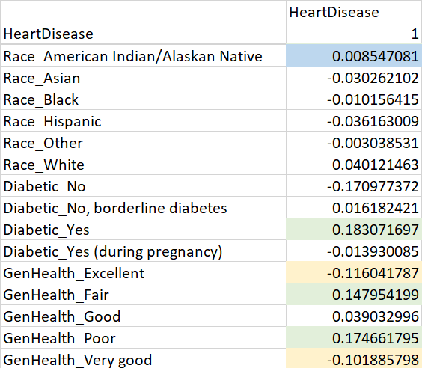
Correlation Between Continuous Variables
Physical health, Age category above 80 or older , a person with diabetic , a person with poor general health has lower positive correlation with the target variable.
A person with an excellent general health shows a lower negative correlation with the target variable.
Sleep time and Race has no correlation with the target variable

Slide 14
DATA STORAGE

Slide 15
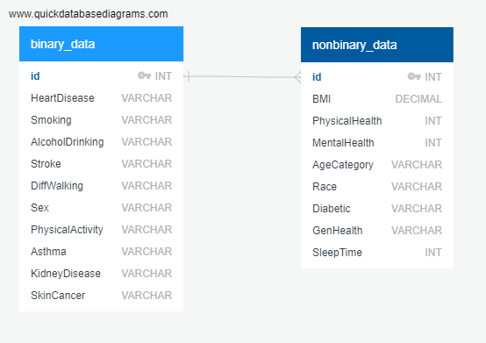

Creating tables for binary and nonbinary data using SQL
Joining tables using id number as the primary key
Storing data using Pgadmin

Slide 16
MACHINE LEARNING MODELS

Slide 17
Results
Definitions and Calculations of Scores
Accuracy: the difference between its predicted values and actual values.
Precision: Precision = TP/(TP + FP) Precision is a measure of how reliable a positive classification is.
Sensitivity = TP/(TP + FN) Sensitivity is a measure of the probability of a positive test, conditioned on truly having the condition.
F1 = 2(Precision * Sensitivity)/(Precision + Sensitivity) A pronounced imbalance between sensitivity and precision will yield a low F1 score.

Slide 18
Before Optimization
Model | Accuracy Score | Precision Score | Recall Score | F1 Score
Logistic Regression Undersampling | 76% | 76% | 76% | 76%
Logistic Regression Oversampling Score | 76% | 77% | 77% | 77%
Random Forest Classifier Undersampling | 64% | 67% | 65% | 64%
Xgboosting | 76% | 76% | 76% | 76%

Slide 19
After Optimization
Model | Accuracy Score | Precision Score | Recall Score | F1 Score
Logistic Regression Undersampling | % | % | % | %
Logistic Regression Oversampling Score | % | % | % | %
Random Forest Classifier Undersampling | % | % | % | %
Xgboosting

Slide 20
DASHBOARD

Slide 21
Dashboard Elements
For the dashboard segment ,we have used Tableau Public and please click here view the interactive dashboard embed.
Prediction of number of people with heart disease will be the key element of the dashboard and how the leading factors interacts with the factors such as alcohol drinking, Diabetic, Kidney Disease and Asthma will be shown on the dashboard.
Some of the leading factors and how it relates with number of heart disease show as follows.

Slide 22
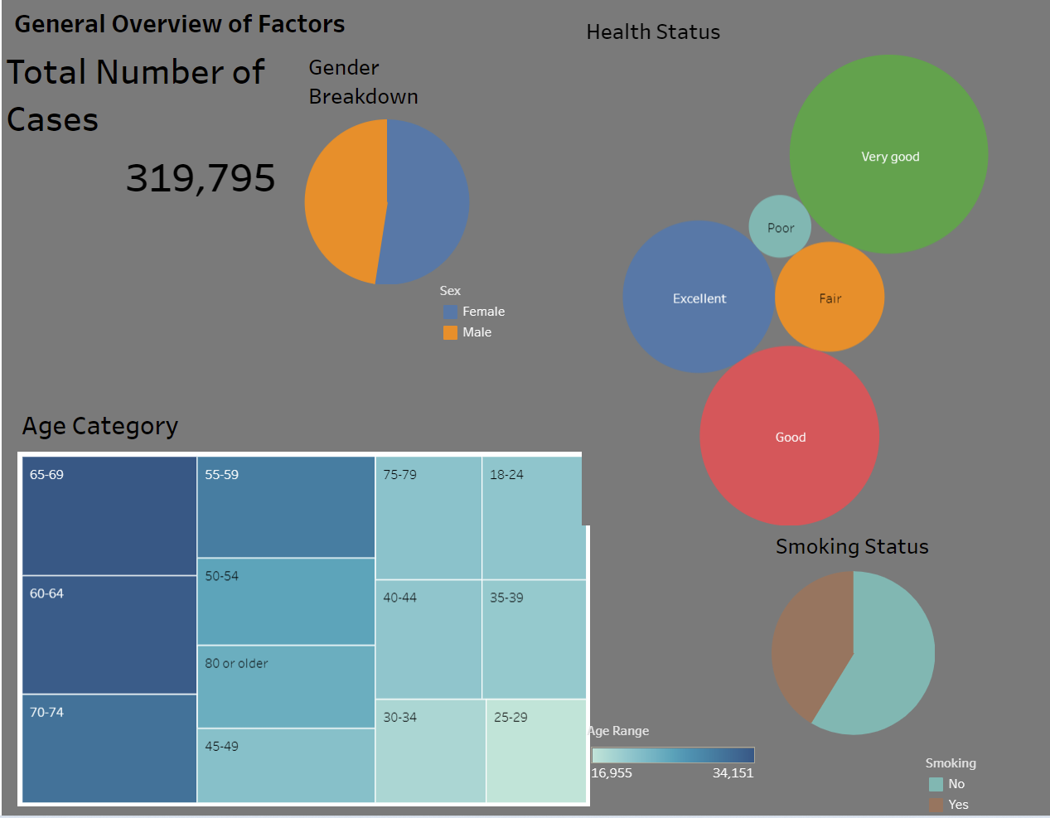
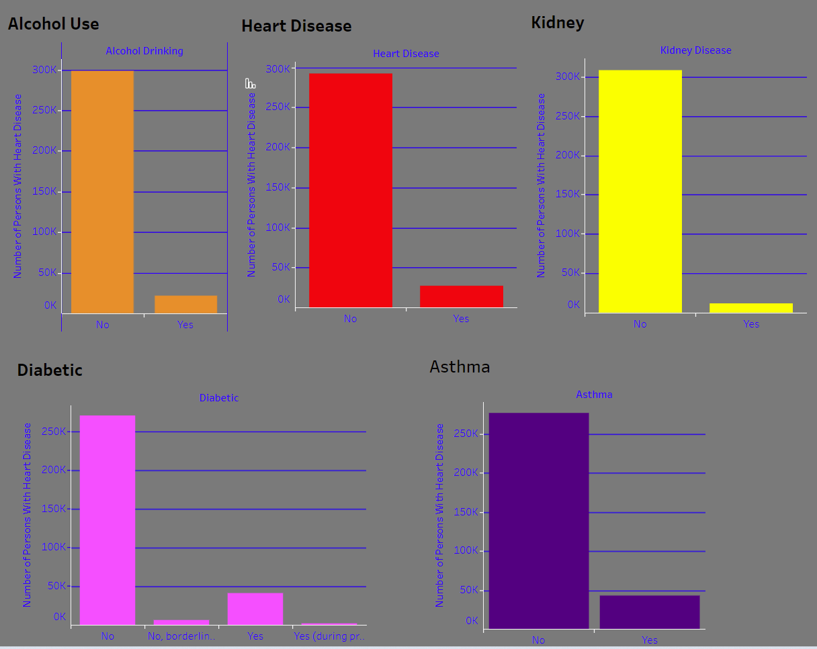
As per the general overview of factors it shows the total number of cases , gender breakdown of the number of people of the given dataset , smoking status , age category and the health status.
As per the bar graphs it shows the no of persons with heart diseases who are using alcohol, who has kidney disease, who are a diabetic patient and who has Asthma. As per the graph it shows a less no of people with above conditions predict heart disease.

Slide 23
CONCLUSION

Slide 24
After completing the project and viewing the predictions , we can see that the machine learning models selected allow us to get a strong prediction from the data provided, specifically by oversampled linear regression model. It consistently had the highest scores, particularly in accuracy, precision, and sensitivity, and thus correctly made the correct predictions compared to the other models.
In conclusion , the data provided can be correlated in determining predicting getting heart disease or not getting heart disease.

Slide 25




The Team
Ethan McBride
Andres Pombo
Sergei Zhukov
Marian Salgadoe
Q & A

Slide 26
THANK YOU !

